Slide 1
Sequence Prediction through LSTMs
Harsh Jain
Ankur Patil
Snehil Yadav
Ayush Jangid

Slide 2
Contents
Introduction to LSTMs 3
More about LSTMs 4
Numerical Experiments 6
Future Ideas 11

Slide 3
Introduction to LSTMs
Neural Networks(NN) have seen the dawn of AI world, but simultaneously it came up with a serious flaw that it does not have memory. So as a result, it works well with the structured data like images and tabular data, but it becomes very difficult to work on sequential data, where one term is linked to previous terms.
Thus the need of giving networks a memory is felt, and Recurrent Neural Networks(RNN) came into play. This solves the memory issue by giving a feedback mechanism that looks to the previous output and serves as a kind of memory, thus forming a sequential action.
But in itself, RNN also came up a flaw of vanishing gradients or not memorizing the sequence longer. Hence the world saw the dawn of Long Short Term Memory(LSTMs) which opposed to RNNs captured both short and long term memory components to efficiently learn sequential data.

Slide 4
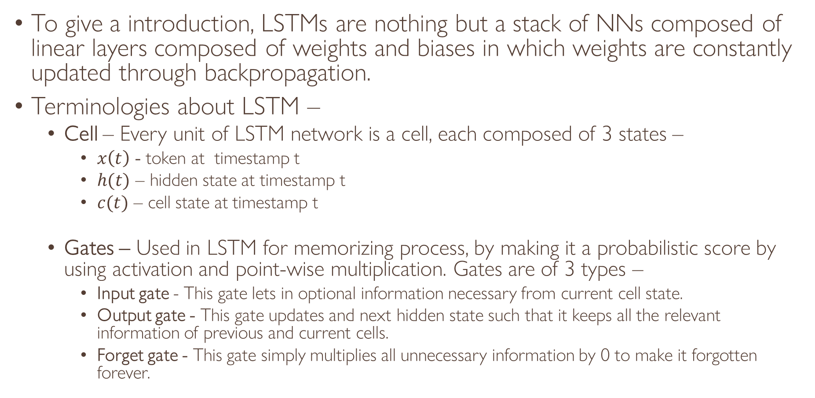
More about LSTMs
To give a introduction, LSTMs are nothing but a stack of NNs composed of linear layers composed of weights and biases in which weights are constantly updated through backpropagation.
Terminologies about LSTM –
Cell – Every unit of LSTM network is a cell, each composed of 3 states –
$x\left(t\right)$ - token at timestamp t
$h(t)$ – hidden state at timestamp t
$c(t)$ – cell state at timestamp t
Gates – Used in LSTM for memorizing process, by making it a probabilistic score by using activation and point-wise multiplication. Gates are of 3 types –
Input gate - This gate lets in optional information necessary from current cell state.
Output gate - This gate updates and next hidden state such that it keeps all the relevant information of previous and current cells.
Forget gate - This gate simply multiplies all unnecessary information by 0 to make it forgotten forever.

Slide 5
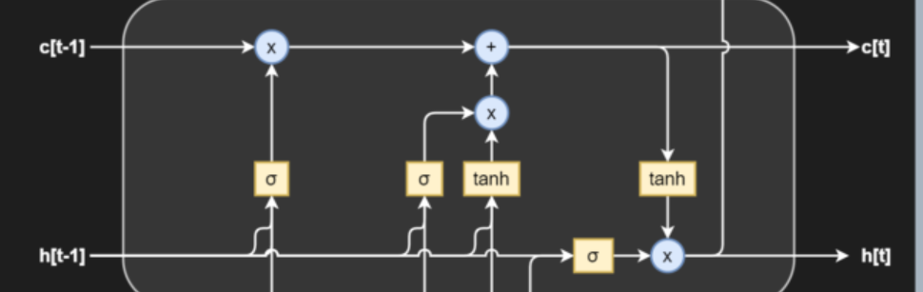
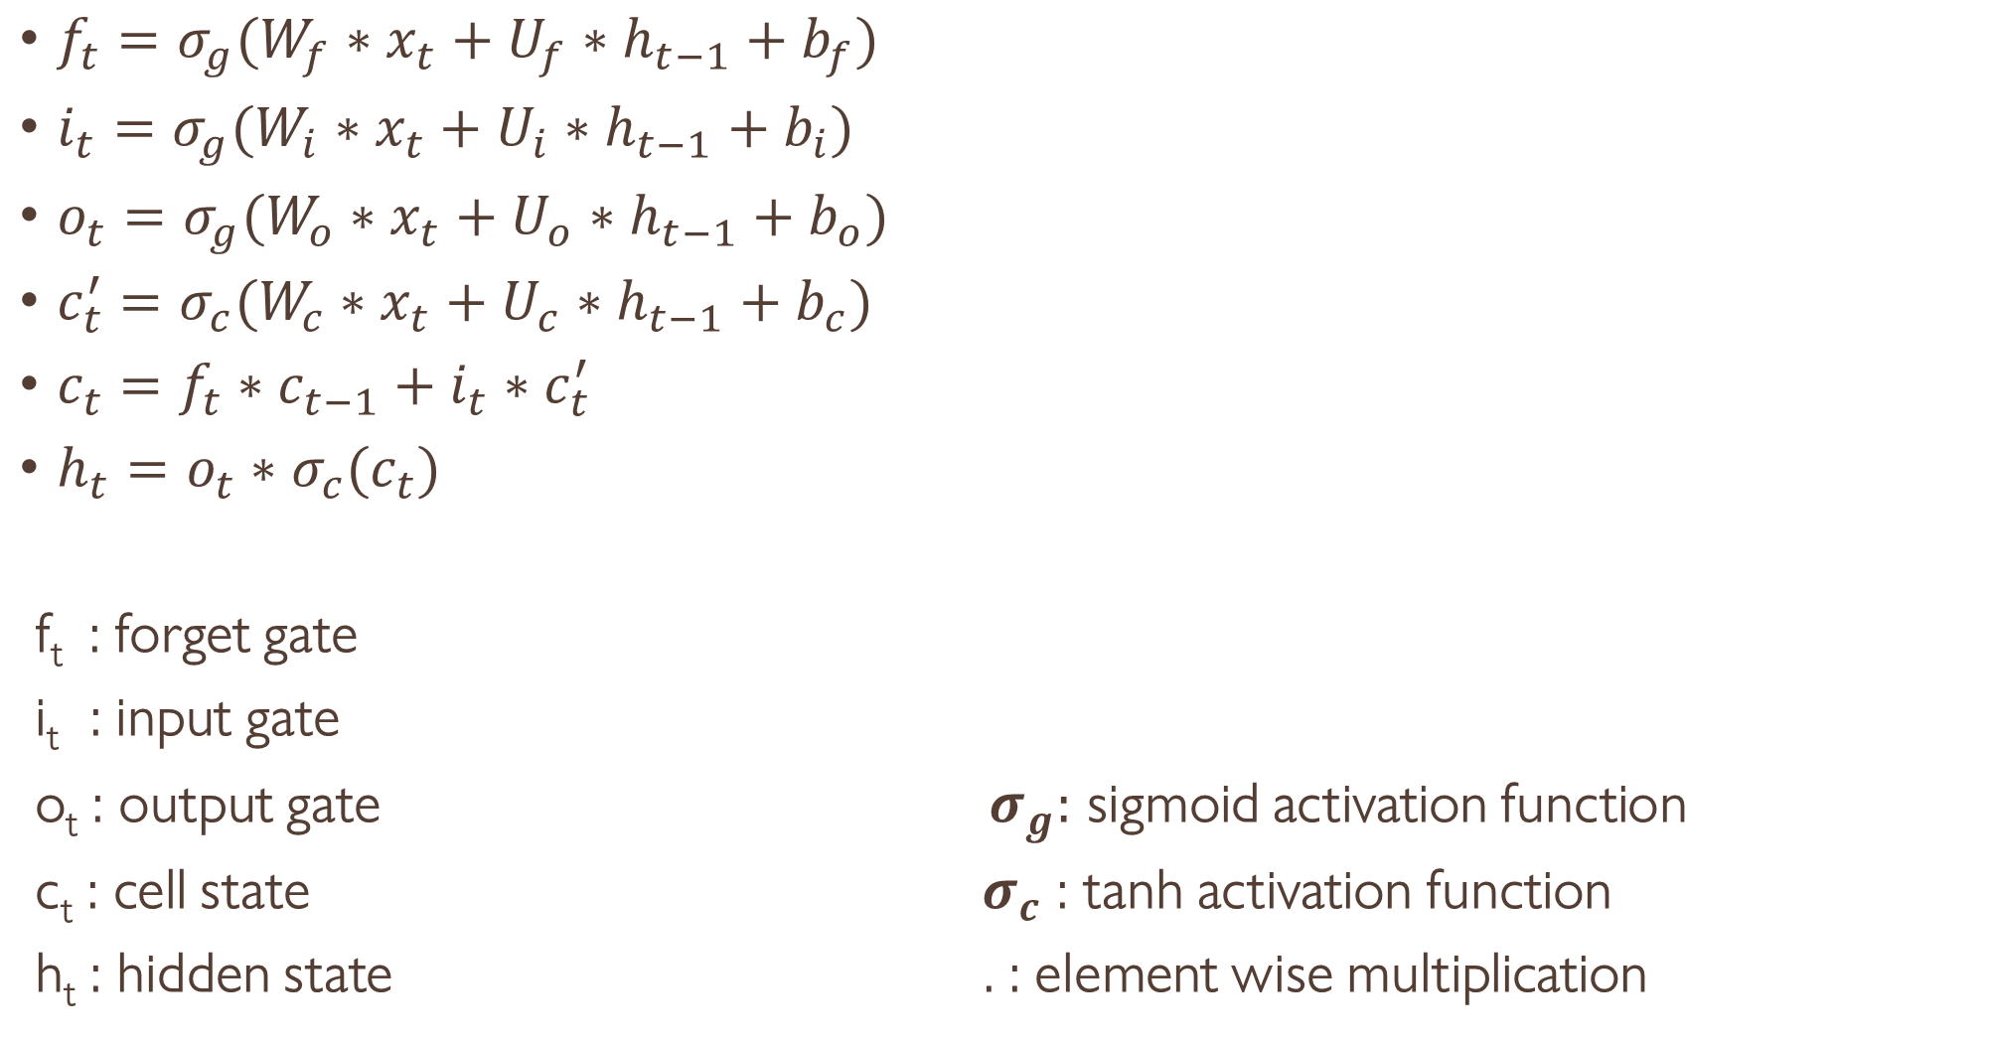
$f_{t}=σ_{g}(W_{f}∗x_{t}+U_{f}∗h_{t−1}+b_{f})$
$i_{t}=σ_{g}(W_{i}∗x_{t}+U_{i}∗h_{t−1}+b_{i})$
$o_{t}=σ_{g}(W_{o}∗x_{t}+U_{o}∗h_{t−1}+b_{o})$
$c_{t}^{′}=σ_{c}(W_{c}∗x_{t}+U_{c}∗h_{t−1}+b_{c})$
$c_{t}=f_{t}∗c_{t−1}+i_{t}∗c_{t}^{′}$
$h_{t}=o_{t}∗σ_{c}(c_{t})$
f_{t} : forget gate
i_{t} : input gate
o_{t} : output gate $σ_{g}:$ sigmoid activation function
c_{t} : cell state $σ_{c}$ : tanh activation function
h_{t} : hidden state . : element wise multiplication
Pictorial Representation of LSTM Cell

Slide 6
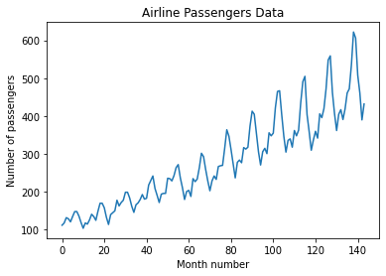
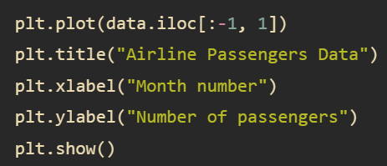
Numerical Experiment
We are taking the data of airlines, in which we are given number of passengers in a given month, and we have to predict the number of passengers in future.
This problem is a sequence prediction problem as we are given a sequence of number of passengers in past months, and we have to predict the number of passengers in the very next month.

Slide 7
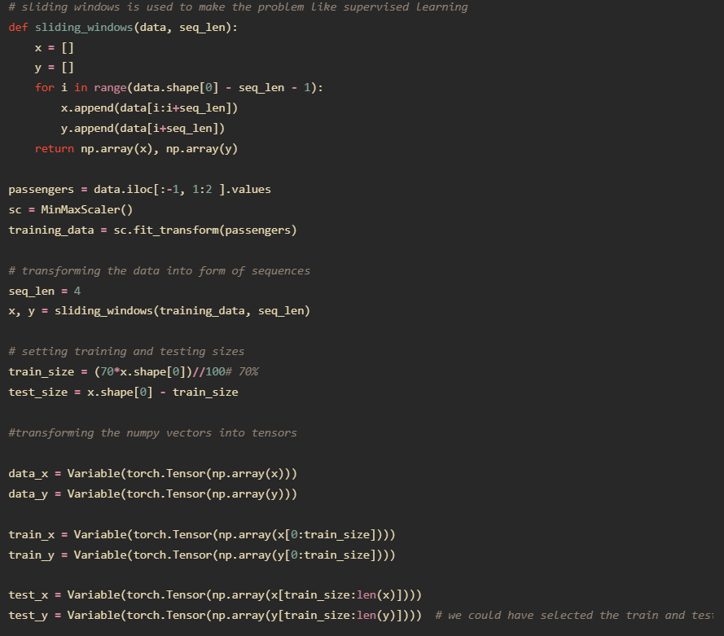
For this, firstly we have to change our data from just a sequence to a array of sequences and their next month projections. This can be done with the help of sliding windows. Then we just form the trainable data and split the data into training set and test set.
Now each row of train_x will
be a sequence of number of passen-
gers in 4 continuous months and
corresponding row in train_y
will store number of passengers
in next month.

Slide 8
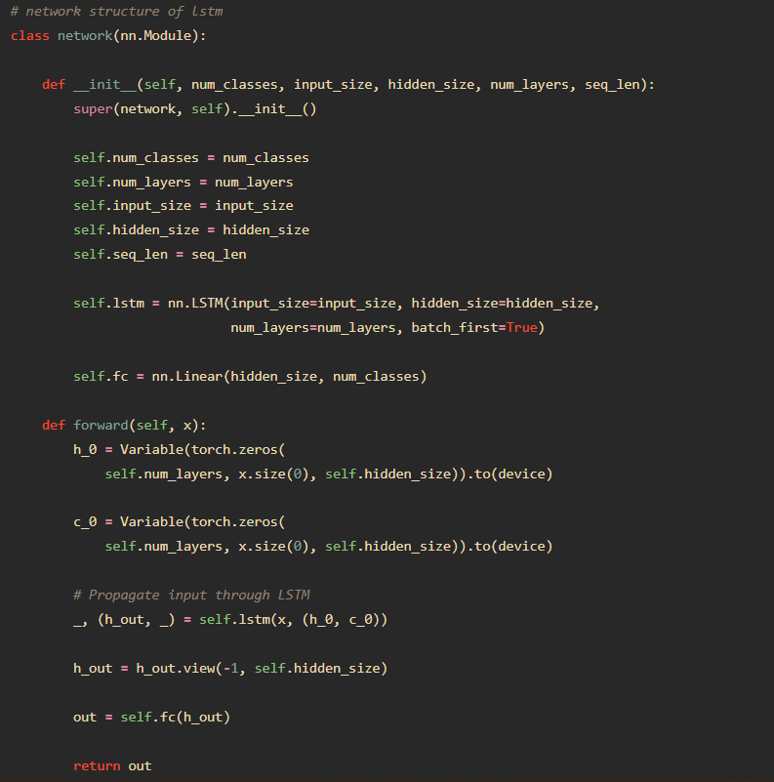
Now we have to form a LSTM
network which takes a sequence
of inputs and outputs(or predicts)
the next term of the input
sequence.
Then we have to initialize the
hyperparameters and the criterion
to calculate loss and the optimizer
to update the weights of the network.

Slide 9
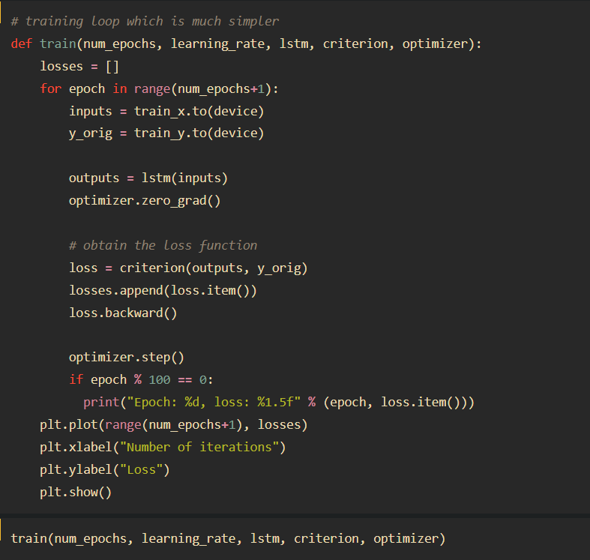
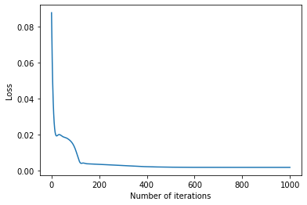
Now we start updating the network and let it train for 1000 epochs and this model after training achieves a loss of 0.00183 starting from 0.08778.

Slide 10
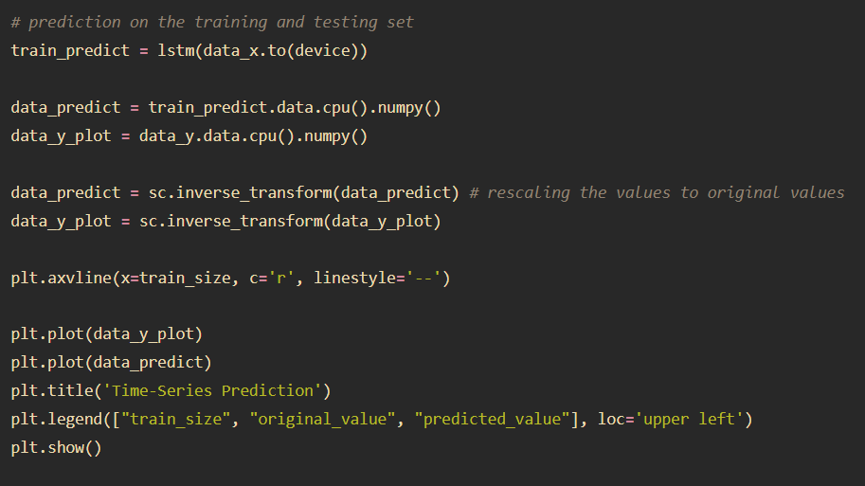
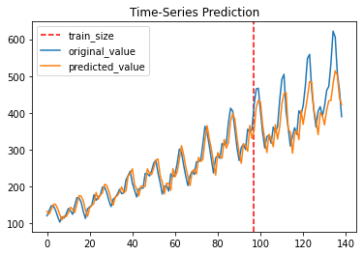
Predictions on the training and testing data

Slide 11
Future Ideas
Now this method of applying LSTM to time-series analysis could be extended for any type of univariate analysis.
For example, we can apply this for language modelling, i,.e. predictive texts like in email by suitably transforming the text data into trainable data.
This idea can be extended for music generation by transforming a sample of audio into trainable data, and give a few starting notes and train our model to give next note of sequence, and applying this repeatedly will give whole music clip.
Furthermore, we can apply this technique to DNA sequencing and protein sequencing as that is also a problem of univariate analysis.

Slide 12
Thank You!!!

